Slide 1
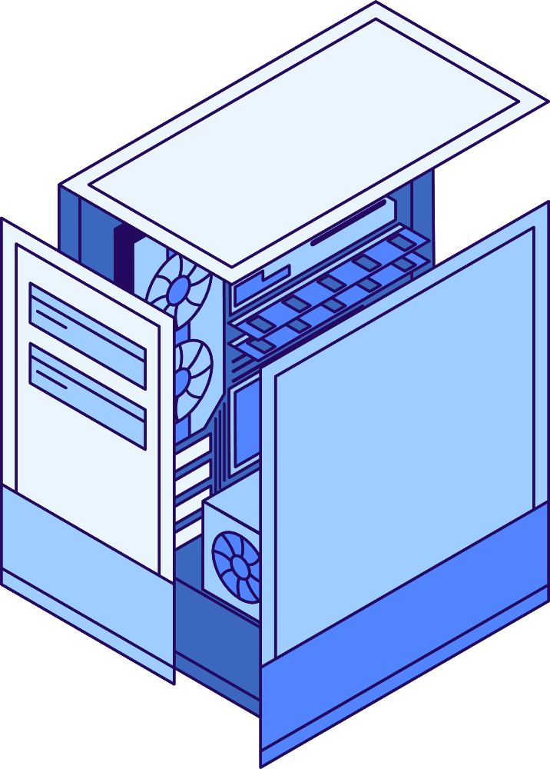
REPLACEMENT ALGORITHM
FIFO
www.reallygreatisite.com

Slide 2



REPLACEMENT ALGORITHM
Replacement algorithms help the operating system manage limited memory by deciding which block or page to remove when new data needs to be loaded. When the cache or RAM becomes full, these algorithms choose the best candidate for replacement to reduce page faults and maintain smooth system performance. Common methods include FIFO, LRU, and Optimal replacement.

Slide 3
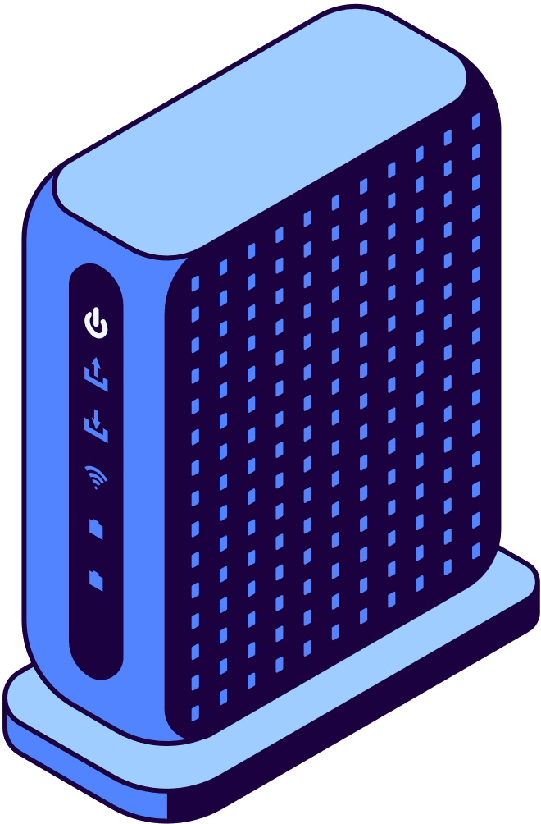

FIFO IN REPLACEMENT ALGORITHM
FIFO (First-In First-Out) is one of the simplest page replacement algorithms. It replaces the page that has been in memory the longest. When a new page arrives and the memory is full, FIFO removes the oldest loaded page and loads the new one in its place. This method is easy to implement and uses a queue-like structure to track the order of pages.

Slide 4


Inside
Desktop

Slide 5
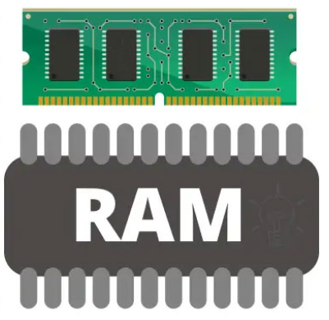

Replacement algorithms like FIFO take place in both the cache and RAM. When either of them becomes full and a new block or page is needed, the operating system or cache controller uses the replacement algorithm to decide which existing entry should be removed and replaced.

Slide 6
How it Works?

Slide 7
  Cache/RAM Capacity:
    The cache or RAM can only hold a limited number of blocks at once.
  Block Request Process:
    When a block is requested, the system checks if it's already in the cache. If it is, a "HIT" occurs, allowing immediate data access.
    If the block is not in the cache, a "MISS" occurs, indicating the need to retrieve the data from a slower storage.
  Handling Available Space:
    If there is an empty frame, the new block is simply placed there.
  When Cache is Full:
    The FIFO (First-In-First-Out) algorithm manages the situation by selecting the block that has been in the cache the longest. This is the block that will be replaced.
    The oldest block is removed, making space for the new block to be inserted.
  Order Tracking:
    To maintain the correct sequence and ensure the oldest block is always replaced, a rotating pointer is employed. This pointer keeps track of the order in which blocks are added.

Slide 8
Flow Diagram
start
Send Block Request
Miss!
Page Found?
Hit!
No
Yes
Places The Block
Stop

Slide 9
Demonstration

Slide 10
Replacement Algorithm
(FIFO)
7 0 1 2 0 3 0 4 2 3 0 3 2 1 2 0 1 7 0 1

Slide 11
Replacement Algorithm
(FIFO)
blocks
7 0 1 2 0 3 0 4 2 3 0 3 2 1 2 0 1 7 0 1

Slide 12

Replacement Algorithm
(FIFO)
cache
7 0 1 2 0 3 0 4 2 3 0 3 2 1 2 0 1 7 0 1

Slide 13













Replacement Algorithm
(FIFO)
7 0 1 2 0 3 0 4 2 3 0 3 2 1 2 0 1 7 0 1

Slide 14
Replacement Algorithm
(FIFO)
7 0 1 2 0 3 0 4 2 3 0 3 2 1 2 0 1 7 0 1

Slide 15
Replacement Algorithm
(FIFO)
7 0 1 2 0 3 0 4 2 3 0 3 2 1 2 0 1 7 0 1

Slide 16
Conclusion

Slide 17

  Replacement algorithms like FIFO manage limited cache and RAM by deciding which block to remove when new data must be loaded.

Slide 18
  Replacement algorithms like FIFO manage limited cache and RAM by deciding which block to remove when new data must be loaded.
  By replacing the oldest or least-needed blocks, they help maintain efficient memory usage and improve system performance.

Slide 19

  Replacement algorithms like FIFO manage limited cache and RAM by deciding which block to remove when new data must be loaded.
  By replacing the oldest or least-needed blocks, they help maintain efficient memory usage and improve system performance.
  These techniques ensure smooth program execution by reducing delays and intelligently handling memory when it becomes full.

Slide 20

Thank you

Slide 21
Thank you
By: Vivek Joseph
Rmca 2025-27
roll no. 60

